Slide 1
CA 7503 Software Testing

Slide 2
Lecture 6 : Static and Dynamic Testing

Slide 3
Major Categories of Verification
There are Two Major Categories of Verification Testing:
Dynamic Testing
Static Testing

Slide 4
Static Testing
Static Testing is type of testing in which the code is not executed.
It can be done manually or by a set of tools.
This type of testing checks the code, requirement documents and design documents and puts review comments on the work document.
When the software is non –operational and inactive, we perform security testing to analyse the software in non-runtime environment.
With static testing, we try to find out the errors, code flaws and potentially malicious code in the software application.
It starts earlier in development life cycle and hence it is also called verification testing.

Slide 5
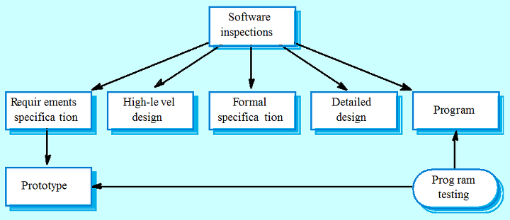
Static Testing
Static testing can be done on work documents like requirement specifications, design documents, source code, test plans, test scripts and test cases, web page content.

Slide 6
Static test techniques include
Inspection: Here the main purpose is to find defects. Code walkthroughs are conducted by moderator. It is a formal type of review where a checklist is prepared to review the work documents.
Walkthrough: In this type of technique a meeting is lead by author to explain the product. Participants can ask questions and a scribe is assigned to make notes.

Slide 7
Static test techniques include
Technical reviews: In this type of static testing a technical round of review is conducted to check if the code is made according to technical specifications and standards. Generally the test plans, test strategy and test scripts are reviewed here.
Informal reviews: Static testing technique in which the document is reviewed informally and informal comments are provided.

Slide 8
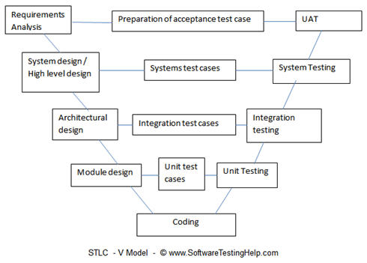
V & V Model

Slide 9
V & V Planning
Careful planning is required to get the most out of testing and Careful planning is required to get the most out of testing and inspection processes.
Planning should start early in the development process.
The plan should identify the balance between static verification and testing.
Test planning is about defining standards for the testing process rather s rather than describing product tests. than describing product tests.

Slide 10
The software test plan
The testing process
A description of the major phases of the testing process. These might be as described earlier.
Requirements traceability
Users are most interested in the system and testing should be planned so that all requirements are individually tested.
Tested items
The products of the software process that are to be tested should be specified.
Testing schedule
An overall testing schedule and resource allocation for this schedule. This, obviously, is linked to the more general project development schedule.

Slide 11
The software test plan
Test recording procedures
It is not enough simply to run tests. The results of the tests must be systematically recorded. It must be possible to audit the testing process to check that it been carried out correctly
Hardware and software requirements
This section should set out software tools required and estimated hardware utilization.
Constraints
Constraints affecting the testing process such as staff shortages should be anticipated in this section.

Slide 12
Software inspections
Involve people examining the source representation with the aim of discovering anomalies and defects
Do not require execution of a system so may be used before implementation
May be applied to any representation of the system (requirements, design, test data, etc.)
Very effective technique for discovering errors

Slide 13
Inspection success
Many different defects may be discovered in a single inspection
In testing, one defect may mask another so several executions are required
The reuse domain and programming knowledge
reviewers are likely to have seen the types of error that commonly arise

Slide 14
Inspection pre-conditions
A precise specification must be available
Team members must be familiar with the organization standards
Syntactically correct code must be available
An error checklist should be prepared
Management must accept that inspection will increase costs early in the software process
Management must not use inspections for staff appraisal

Slide 15
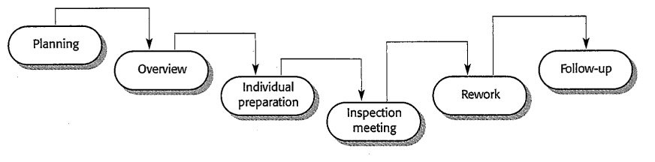
The Inspection Process

Slide 16
Advantages of inspections
During testing, errors can mask (hide) other errors. Because inspection is a static process, you don't have to be concerned with interactions between errors.
Incomplete versions of a system can be inspected without additional costs. If a program is incomplete, then you need to develop specialized test harnesses to test the parts that are available.
As well as searching for program defects, an inspection can also consider broader quality attributes of a program, such as compliance with standards, portability and maintainability.

Slide 17
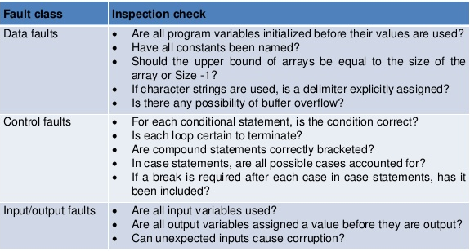
Inspection Checklists

Slide 18
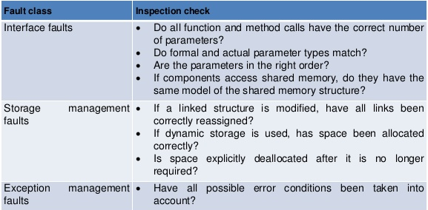
Inspection Checklists

Slide 19
Static Black-Box Testing: Testing the Specification
Testing the specification is static black-box testing.
The specification is a document, not an executing program, so it’s considered static.
What do you do if your project doesn’t have a spec?
Maybe your team is using the big-bang model or a loose code-and-fix model.
As a tester, this is a difficult position.
Although the spec may not be written down, someone, or several people, know what they’re trying to build
Tell your project team, “This is what Iplan to test and submit bugs against.”

Slide 20
Dynamic Testing
Dynamic testing is done when the code is in operation mode.
Dynamic testing is performed in runtime environment.
When the code being executed is input with a value, the result or the output of the code is checked and compared with the expected output.
With this we can observe the functional behavior of the software, monitor the system memory, CPU response time, performance of the system.
Dynamic testing is also known as validation testing, evaluating the finished product.
Dynamic testing is of two types: Functional Testing and Non functional testing.

Slide 21
Types of Dynamic Testing techniques
Unit Testing: Testing of individual modules by developers.. The source code is tested in it.
Integration Testing: Testing the interface between different modules then they are joined..
System Testing: Testing performed on the system as a whole.
Acceptance Testing: Testing done from user point of view at user’s end.

Slide 22
Difference between Static Testing and Dynamic Testing
Static Testing | Dynamic Testing
1. Static Testing is white box testing which is done at early stage if development life cycle. It is more cost effective than dynamic testing | 1. Dynamic Testing on the other hand is done at the later stage of development lifecycle.
2. Static testing has more statement coverage than dynamic testing in shorter time | 2. Dynamic Testing has less statement stage because it is covers limited area of code
3. It is done before code deployment | 3. It is done after code deployment
4. It is performed in Verification Stage | 4. It is done in Validation Stage
5. This type of testing is done without the execution of code. | 5. This type of execution is done with the execution of code.

Slide 23
Difference between Static Testing and Dynamic Testing
Static Testing | Dynamic Testing
6.Static testing gives assessment of code as well as documentation. | 6. Dynamic Testing gives bottlenecks of the software system.
7. In Static Testing techniques a checklist is prepared for testing process | 7. In Dynamic Testing technique the test cases are executed.
8. Static Testing Methods include Walkthroughs, code review. | 8. Dynamic testing involves functional and nonfunctional testing

Slide 24
Example
Software Application: Online Shopping Cart
Static Test Techniques:
Review the requirement documents, design documents initially
Checking the GUI of the application
Checking the database structure of the application.
Dynamic Testing Techniques:
Testing the functionality of the different page.
Checking the checkout process and payment methods.
Testing the interfaces between different pages.

Slide 25
Performing a High-Level Review of the Specification
Defining a software product is a difficult process.
The process is an inexact science and is prone to having problems.
The first step in testing the specification isn’t to jump in and look for specific bugs.
The first step is to stand back and view it from a high level.
Examine the spec for large fundamental problems, oversights, and omissions.
You might consider this more research than testing, but ultimately the research is a means to better understand what the software should do.

Slide 26
Pretend to Be the Customer
The easiest thing for a tester to do when he first receives a specification for review is to pretend to be the customer.
Do some research about who the customers will be.
It’s important to understand the customer’s expectations. Remember that the definition of quality means “meeting the customer’s needs.”
If you review a portion of the spec and don’t understand it, don’t assume that it’s correct and go on. Eventually, you’ll have to use this specification to design your software tests, so you’ll eventually have to understand it.

Slide 27
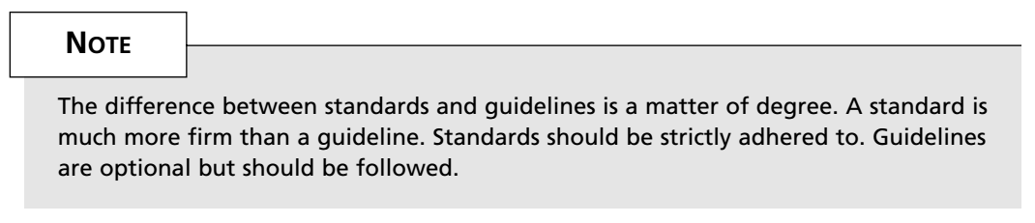
Research Existing Standards and Guidelines
You should research what might apply to your software:
Corporate Terminology and Conventions. If this software is tailored for a specific company, it should adopt the common terms and conventions used by the employees of that company.
Industry Requirements. The medical, pharmaceutical, industrial, and financial industries have very strict standards that their software must follow.
Government Standards. The government, especially the military, has strict standards.
Graphical User Interface (GUI). If your software runs under Microsoft Windows or Apple Macintosh operating systems, there are published standards and guidelines for how the software should look and feel to a user.
Hardware and Networking Standards. Low-level software and hardware interface standards must be adhered to, to assure compatibility across systems.
As a tester, your job isn’t to define what guidelines and standards should be applied to your software.
Consider them as part of the specification.

Slide 28
Review and Test Similar Software
One of the best methods for understanding what your product will become is to research similar software.
The software likely won’t be an exact match but it should help you think about test situations and test approaches.
Some things to look for when reviewing competitive products include
Scale. Will your software be smaller or larger? Will that size make a difference in your testing?
Complexity. Will your software be more or less complex? Will this impact your testing?
Testability. Will you have the resources, time, and expertise to test software such as this?
Quality/Reliability. Is this software representative of the overall quality planned for your software? Will your software be more or less reliable?

Slide 29
Low-Level Specification Test Techniques
After you complete the high-level review of the product specification, you’ll have a better understanding of what your product is and what external influences affect its design.

Slide 30
Specification Attributes Checklist
A good, well-thought-out product specification, with “all its t’s crossed and its i’s dotted,” has eight important attributes:
Complete. Is anything missing or forgotten? Is it thorough? Does it include everything necessary to make it stand alone?
Accurate. Is the proposed solution correct? Does it properly define the goal? Are there any errors?
Precise, Unambiguous, and Clear. Is the description exact and not vague? Is there a single interpretation? Is it easy to read and understandable?
Consistent. Is the description of the feature written so that it doesn’t conflict with itself or other items in the specification?

Slide 31
Specification Attributes Checklist
Relevant. Is the statement necessary to specify the feature? Is it extra information that should be left out? Is the feature traceable to an original customer need?
Feasible. Can the feature be implemented with the available personnel, tools, and resources within the specified budget and schedule?
Code-free. Does the specification stick with defining the product and not the underlying software design, architecture, and code?
Testable. Can the feature be tested? Is enough information provided that a tester could create tests to verify its operation?

Slide 32
Specification Terminology Checklist
A complement to the previous attributes list is a list of problem words to look for while reviewing a specification.
The appearance of these words often signifies that a feature isn’t yet completely thought out
The spec may go on to clarify or elaborate on them, or it may leave them ambiguous - in which case, you’ve found a bug.

Slide 33
Specification Terminology Checklist
Always, Every, All, None, Never. If you see words such as these that denote something as certain or absolute, make sure that it is, indeed, certain. Put on your tester’s hat and think of cases that violate them.
Certainly, Therefore, Clearly, Obviously, Evidently. These words tend to persuade you into accepting something as a given. Don’t fall into the trap.
Some, Sometimes, Often, Usually, Ordinarily, Customarily, Most, Mostly. These words are too vague. It’s impossible to test a feature that operates “sometimes.”
Etc., And So Forth, And So On, Such As. Lists that finish with words such as these aren’t testable. Lists need to be absolute or explained so that there’s no confusion as to how the series is generated and what appears next in the list.

Slide 34
Specification Terminology Checklist
Good, Fast, Cheap, Efficient, Small, Stable. These are unquantifiable terms. They aren’t testable. If they appear in a specification, they must be further defined to explain exactly what they mean.
Handled, Processed, Rejected, Skipped, Eliminated. These terms can hide large amounts of functionality that need to be specified.
If…Then…(but missing Else). Look for statements that have “If…Then” clauses but don’t have a matching “Else.” Ask yourself what will happen if the “if” doesn’t happen.

